Slide 1


Paraphrase Identification
A study in linguistics
And natural language processing

Slide 2

Background
Do people invest their time in Linguistics?
What can you do with a degree in Linguistics?
What is Linguistics?
What are the tools that linguists have provided?
Are they useful?
Do the tools explain the theory?

Slide 3
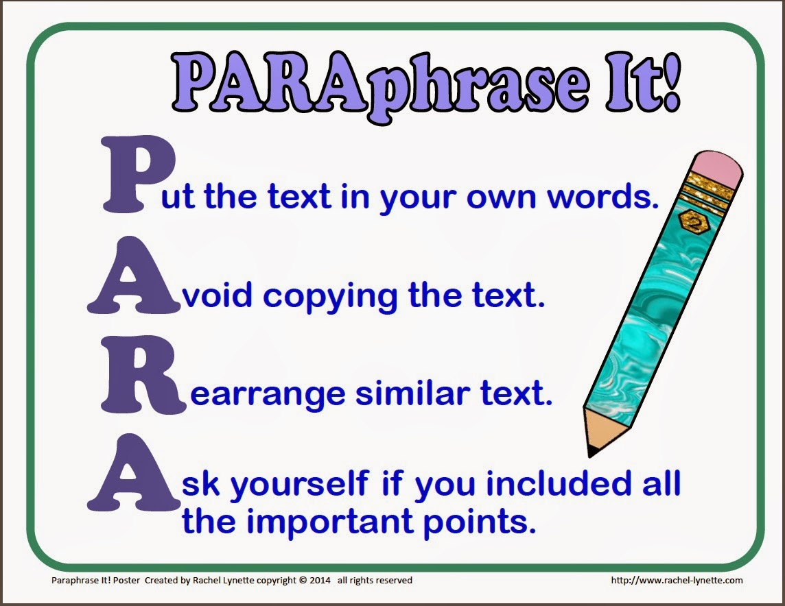

Something New
What can I provide as a student of Linguistics?
Have people done this before?
What is a paraphrase?
Why is this important?
Case study

Slide 4

What can be done but shouldn’t be done
What can we do to make it better?
Was it worth the effort?

Slide 5

Theory of Grammar
A theory of grammar is essentially a theory of the mind.
What is the mind?
Why is pattern recognition so important?

Slide 6
What do we Understand?
Is any given speaker of English as a second language good at English?
Gradient Grammar
What do we actually know about grammar?

Slide 7
Results
The original assumption
It can only be a paraphrase if the words occur in the same order
Is it going to be accurate?
Can we trust the tool?

Slide 8

Conclusion
We can all use a tool like this.
Focusing on the main issues will make our lives better.

